Slide 1




ACCREDITATION OF HEALTH CARE FACILITIES AND SERVICES
(5TH EDITION HOSPITAL ACCREDITATION STANDARDS)
Assoc. Prof. Dr. M.A. Kadar Marikar
Chief Executive Officer, MSQH

Slide 2

1.Overview of MSQH
Enhancing Patient Safety and Quality of Care Nationally
Initiated by MoH
Formed through smart partnership between public, private and professional bodies
Non-governmental
Formed 1997 (ROS)
Accredited over 142 hospitals
National Accreditation Body for healthcare facilities and services
Recognised by Standards Malaysia
Internationally certified by ISQua
Non-profit

Slide 3
Vision
The internationally recognised accreditation organisation for the promotion and improvement of quality and safety in healthcare.
Mission
Advocating, education and monitoring continuous quality improvement and patient safety in healthcare

Slide 4

National Recognition
1. Ministry of Health 2006
2. Standards Malaysia 2009
International Recognition
ISQua Certification 2016 - 2020

Slide 5
2.Accreditation: Global Scenario
Accreditation is an internationally recognised evaluation process used to assess and improve the:
  Quality
  Efficiency and effectiveness of Healthcare Organisations
  Focus on Patient Safety

Slide 6
Accreditation is based on the premise that adherence to evidence based standards will produce higher quality health care services in an increasingly safe environment.
It is also a way to publically recognized that a healthcare organisations has met national quality standards.

Slide 7
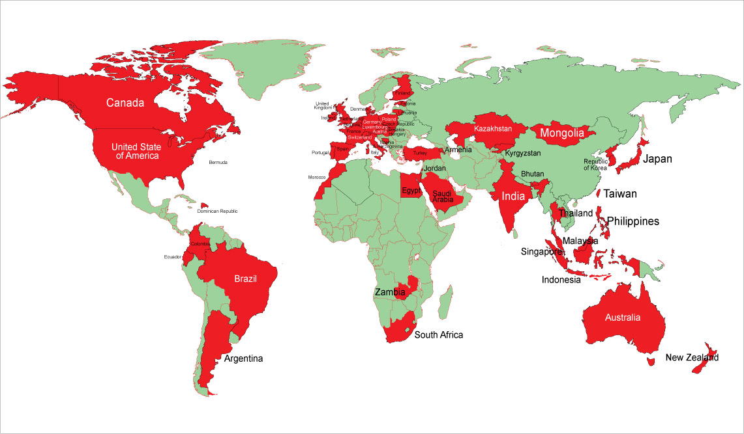
Countries with Accreditation Programs
Countries with National Accreditation Services

Slide 8
Accreditation of Healthcare
An integral part of healthcare systems in over 70 countries
ISQua (International Society for Quality in Healthcare) is the largest associated international body that accredits national accreditation bodies world wide
Voluntary in most countries
  Later mandatory by default (due to Financing Requirements)
Mandatory in some countries; e.g. France and Taiwan

Slide 9
Accreditation of Healthcare (Cont’d)
Its rapid growth over the last 40 years is partially attributed to media reporting of services inadequacies in the quality and safety of healthcare services, and escalating forces on Patient Safety

Slide 10
Healthcare Facilities & Services Accreditation Program
  Consists of periodic or cyclical assessment of organisational and clinical practices
  The measurement of their performance against pre-established, evidence-based standards
  3 to 5 year cycle

Slide 11
Healthcare Facilities & Services Accreditation Program (Cont’d)
This is usually done through;
  Self- assessments
  Peer review/surveyor on site visits
  Interviews by the surveyors
  Careful study of administrative and clinical processes documentation and data
The process typically culminates in the provision of accreditation report and accreditation status

Slide 12
3.Quality Improvement in Accreditation Programs
Improvement gradients are embedded into the healthcare accreditation process
Improvements
CQI
Standards
1st Ed
2nd Ed
3rd Ed
4th Ed
5th Ed
Time

Slide 13
Quality Improvement in Accreditation Programs (Cont’d)
The standards encourage organizations to achieve particular criteria
Accrediting Agency/Bodies revise their standards over time so they are based on up-to-date research and accepted best practices (between 3 to 5 years)

Slide 14
Quality Improvement in Accreditation Programs (Cont’d)
Both the above elements elicit continuous quality improvement efforts
GOAL
To contribute to the provision of high quality and safe healthcare services and
To improve patients’ health outcomes

Slide 15
4.Framework of MSQH Standards
STRUCTURE
PROCESS
OUTCOME
(What are the things
that you have)
(What do you do
With these things)
(What is the result of what you do with these things that you have)

Slide 16
Dimension of Quality in MSQH Standards
Enhancing Patient Safety
Access
Appropriateness
Patient Centered
Safety
Effectiveness
Efficiency

Slide 17
Focus of Standards
Organization & Management
Human Resource Management and Development
Policies & Procedures
Facilities & Equipment
Safety and Performance Improvement Activities
Specific Requirements

Slide 18
5.MSQH Certification Roadmap
Certification:
High Performance Organisation
( Safe Healthcare Facilities & Services)
Pre-requisite: Organisational achievement in self-assessment and CQI
Accreditation Survey: Validation of Organisation – Wide Performance
Licensing (MOH)
Compliance to Private Health Care Facilities and Services Act 1998 & Regulations 2006

Slide 19
Accreditation of Healthcare Facilities & Services
A voluntary process by which MSQH grants recognition to healthcare facilities and services which meet established national standards that require continuous improvement in Structures, Processes and Outcomes.

Slide 20
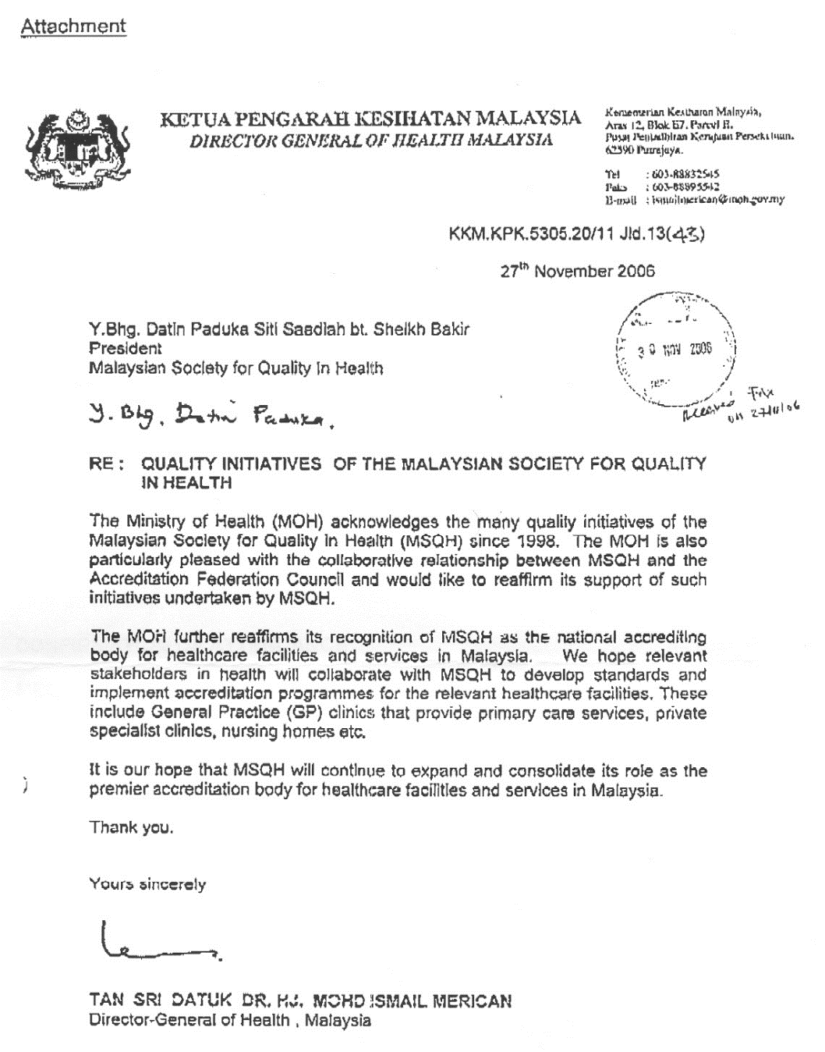
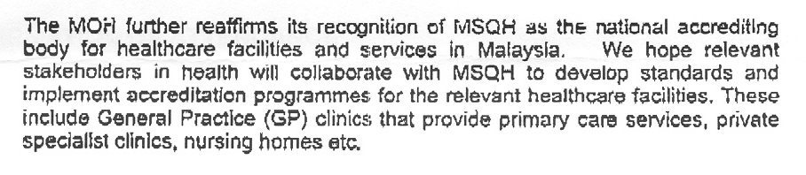
MSQH
Tan Sri Datuk Dr. Ismail Merican
Director General of Health Malaysia
National Accrediting Body for Healthcare Facilities and Services in Malaysia

Slide 21
HOSPITAL ACCREDITATION STANDARDS 5TH EDITION
EFFECTIVE FOR IMPLEMENTATION July 2017
Organization accredited by ISQua,3rd cycle from 2016 to 2020
5th Edition Hospital Standards undergoing ISQua certification in May 2017.
Surveyors Training Programme accredited by ISQua from 2011-2015, 2016 -2020

Slide 22


PHILOSOPHY of MSQH
Hospital Accreditation Program
Educational-Peer Review
Creating Quality Culture
Continuous Quality Improvement
Enhancing Patient Safety
Educator
Enabler
Evaluator

Slide 23

Working Definition:
“Accreditation is a self-assessment and external peer review process used by healthcare organizations to accurately assess their level of performance in relation to established standards and to implement ways to continuously improve the healthcare system”
- ISQua definition: Federation Operating Rules 1998
STANDARDS
PERFORMANCE
Continuous Quality Improvement

Slide 24
WHY ACCREDITATION
To provide the best possible care to the patient (Achieving optimum results from available resources) :
    Safe care in a safe environment.
    Adherence to professional and ethical practice.
    Appropriate management and treatment.
    Value for money service.
As a proactive measure to satisfy customer’s need.
National system for assessing quality in healthcare organisation.

Slide 25
HOSPITAL-WIDE APPROACH
Outsourced Services Offsite
Individuals
¡¡
¡¡
¡¡
¡¡
¡¡
¡¡
Departments / Units
¡¡
¡¡
¡¡
¡¡
¡¡
¡¡
¡¡
¡¡
Outsourced Services On Site
¡¡
¡¡
Organisations System (Governing Body)
¡¡
¡¡

Slide 26

STRENGTHENING OF PATIENT SAFETY
STRATEGIES AND INDICATORS INTO THE MSQH HOSPITAL ACCREDITATION STANDARDS 5TH EDITION
Organizational wide Service Standards
  1.Governance, Leadership and Direction
  2.Environmental and Safety Services
  3.Facility and Biomedical Equipment Management and Safety
  4.Nursing Services
  5.Prevention and Control of Infection
  6.Patient and Family Rights
  7.Health Information Management System (HIMS)

Slide 27

  II. Service Standards
  8. Emergency Services
  9. Clinical Services – Non-Specialist Facility
  9A Clinical Services - Medical Related Services
  9B Clinical Services - Surgical Related Services
  9C Clinical Services – Obstetrics & Gynaecology Services
  9D Clinical Services – Paediatric Services
  9E Clinical Services – Cardiology Services
  9F Clinical Services – Oncology Services
10. Anaesthetic Services
11. Operating Suite Services
12. Ambulatory Care Service
13. Critical Care Services - ICU/CCU/CICU/CRW/HDW/BURNS CARE UNIT
13A Critical Care Services – SCN/NICU/PICU/PHDW

Slide 28
13B Critical Care Services – Labour/Delivery Services
13C Chronic Dialysis Treatment
14. Radiology/Diagnostic Imaging Services
15. Pathology Services
16. Blood Transfusion Services
17. Rehabilitation Medicine Services
- Specific Requirements
17A Allied Health Professional Services -Physiotherapy Services
17B Allied Health Professional Services - Occupational Therapy
Services
17C Allied Health Professional Services - Dietetic Services
17D Allied Health Professional Services – Speech-Language
Therapy
17E Allied Health Professional Services – Audiology Services
17F Allied Health Professional Services – Optometry Services
17G Allied Health Professional Services – Health Education Services

Slide 29
17H Allied Health Professional Services – Medical Social Services
17I Allied Health Professional Services – Psychology Counseling Services
17J Allied Health Professional Services – Clinical Psychology Services
18. Pharmacy Services
19. Central Sterilising Supply Services
20. Housekeeping Services
21. Linen Services
22. Food Services
23. Forensic Medicine Services
23A Mortuary Services
24. Standards for General Applications
24A Standards for Clinical Research Centre

Slide 30
FOCUS OF STANDARDS
STRUCTURE
PROCESS
OUTCOME
(What are the things
that you have)
(What do you do
With these things)
(What is the result of what you do with these things that you have)
Notes:
30
30

Slide 31
WHO Patient Safety Goals |  | Malaysian Patient Safety Goals
1 | Identify patient correctly | G5 | To improve the accuracy of patient Identification
2 | Improve effective communication | G8 | To improve clinical communication by implementing a critical test and critical value program
3 | Improve the safety of high-alert medications | G7 | To improve Medication Safety
4 | Ensure correct-site, correct-procedure, correct-patient surgery | G3 | To implement 2nd Global Patient Safety Challenge-“Safe Surgery Saves Lives”
5 | Reduce the risk of healthcare associated infections. | G2 G10 G12 | To implement 1st Global Patient Safety Challenge- “Clean Care is Safer Care” To reduce the incidence of healthcare associated pressure ulcer To reduce Ventilator Associated Pneumonia(VAP)
6 | Reduce the risk of patient harm resulting from fall | G9 | To Reduce Patient Fall
 | Patient Safety Solutions
1 | Look-Alike, Sound-Alike Medication Names | G7 | To improve Medication Safety
2 | Patient Identification. | G5 | To improve the accuracy of patient Identification
3 | Communication During Patient Hand-Overs. | G8 | To improve clinical communication by implementing a critical test and critical value program
4 | Performance of Correct Procedure at Correct Body Site. | G3 | To implement 2nd Global Patient Safety Challenge-“Safe Surgery Saves Lives”
5 | Control of Concentrated Electrolyte Solutions | G7 | To improve Medication Safety
6 | Assuring Medication Accuracy at Transitions in Care. | G7 | To improve Medication Safety
7 | Avoiding Catheter and Tubing Misconnections. | G11 | To reduce Catheter Related Blood Stream Infection(CRBSI)
8 | Single Use of Injection Devices. | G2 | To implement 1st Global Patient Safety Challenge- “Clean Care is Safer Care”
 |  | G1 | To implement Clinical Governance
 |  | G13 | To implement the Patient Safety Incident Reporting and Learning System

Slide 33
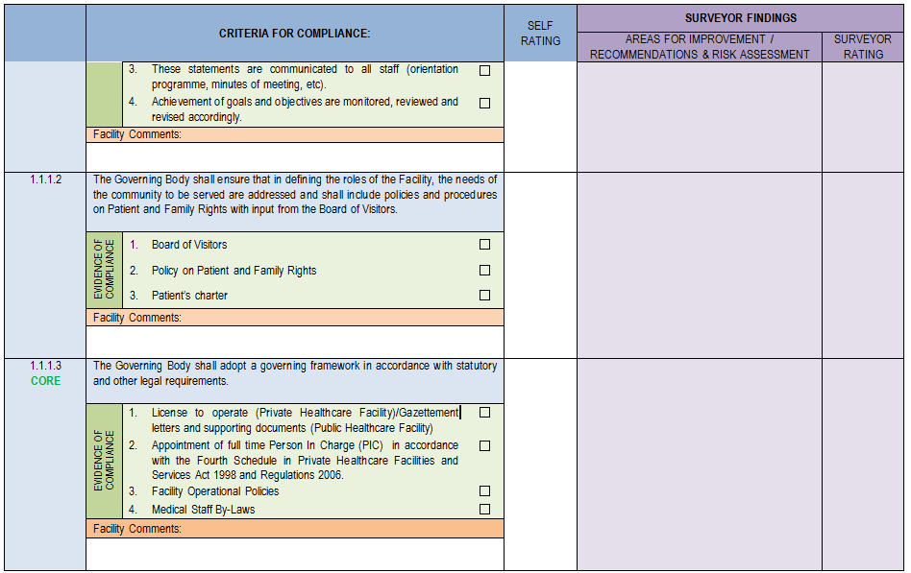

Slide 34
List of Performance Indicators
Standard No.1 | SERVICE STANDARD 1: GOVERNANCE, LEADERSHIP & DIRECTION percentage of patients leaving hospital against medical advice relative to all patients hospitalised within a specified period. percentage of incidents/accidents during hospitalisation of patients as percentage of all admitted patients. hospital wide patient satisfaction survey (six monthly basis) In addition, healthcare facilities are required to monitor any other two (2) indicators with tracking and trending analysis to support its goals and objectives.
Standard No.2 | SERVICE STANDARD 2: ENVIRONMENTAL AND SAFETY SERVICES percentage of new staff (includes all on-site outsourced service providers) given orientation on Environmental, Safety and Health Policy and Programme (Target: 80%) percentage of staff given continuous training in specific aspects of Environmental, Safety and Health (Target: 80%) percentage of workplace hazards identified and risk managed (Target: 100%)
Standard No.3 | SERVICE STANDARD 3: FACILITY AND BIOMEDICAL EQUIPMENT MANAGEMENT AND SAFETY 1. percentage of planned preventive maintenance being done on schedule (Target: 98%) 2. percentage of work orders completed on schedule (Target: 98%) 3. percentage of system/service down time (Target: 5%) 4. response time to equipment failure (Target: Critical care equipment – 15 minutes, Others equipment – 30 minutes)

Slide 35
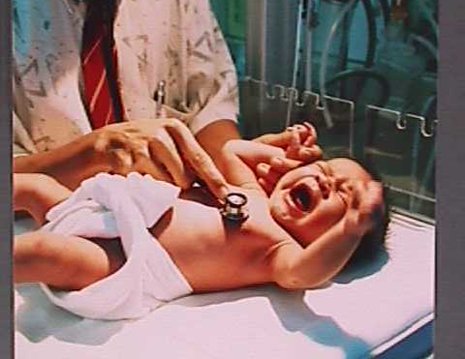
CONTINUOUS IMPROVEMENT USING QUALITY INDICATORS
Neonatal Deaths from Hospital Acquired Infections
2007
2008
2009
15%
2%
Department of Pediatrics

Slide 36
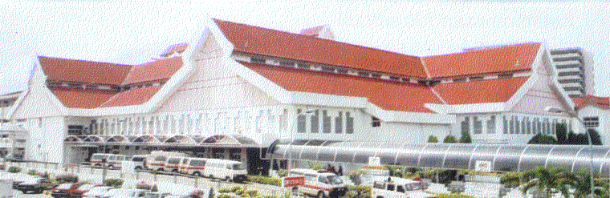
Certification Process
Takes into consideration the following areas that impact Patient Safety:
1.Physical structure:
Size of organization
Category of institution
Layout
Design
Safety features (environment, facilities and equipment )
2.Organizational structure;
Clinical governance
Adequate, trained and competent and safe staff

Slide 37

Certification Process cont..
3.Process:
Current, evidence based practices,
Documentation available and accessible
Risks identified, preventive measures instituted
Patient participation in care process
Evidence of compliance to standard practice

Slide 38

Certification Process cont..
4.Outcome measurements and Continuous quality improvement
Specific Performances
indicators
Client satisfaction

Slide 39
RESOURCES
CODE OF CONDUCT / ETHICS
EVIDENCE BASED MEDICINE
CUSTOMER SATISFACTION
ACCREDITATION AWARD
QUALITY OF CARE
MSQH SERVICE STANDARDS ON PROVIDERS
ORG & MGMT
HRM
F & E
P & P
Q I A
S
P
O
DOCUMENTATION
EVIDENCE OF PRACTICE
Notes:
39

Slide 40
Preparation towards survey
VOLUNTARY REQUEST
PREPARATION & STANDARDS INTERPRETATION
SELF-EVALUATION BY FACILITY
AGREEMENT ON SURVEY DATES
SURVEYORS’IDENTIFICATION/APPOINTMENT/CONSENSUS
PRE-SURVEY ASSESSMENT
SURVEY
(On site)

Slide 41
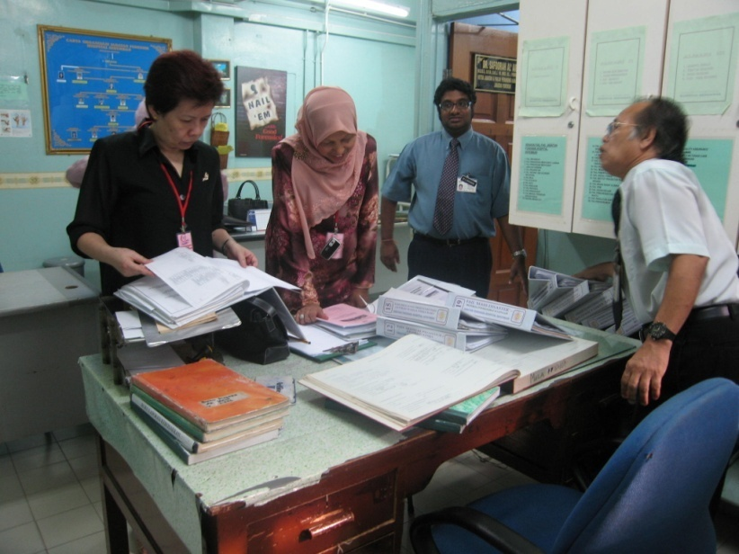
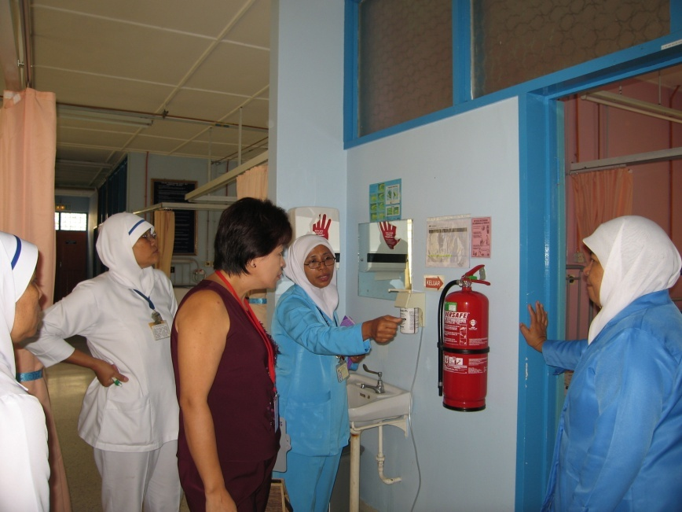
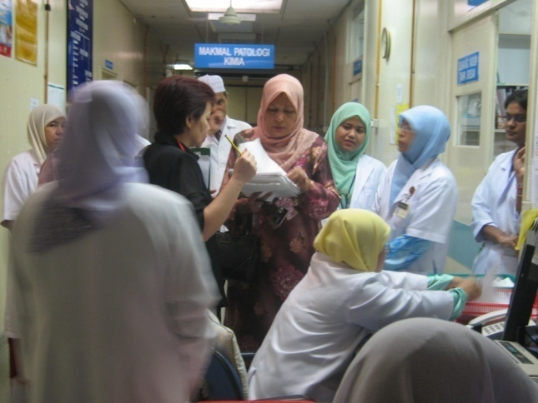
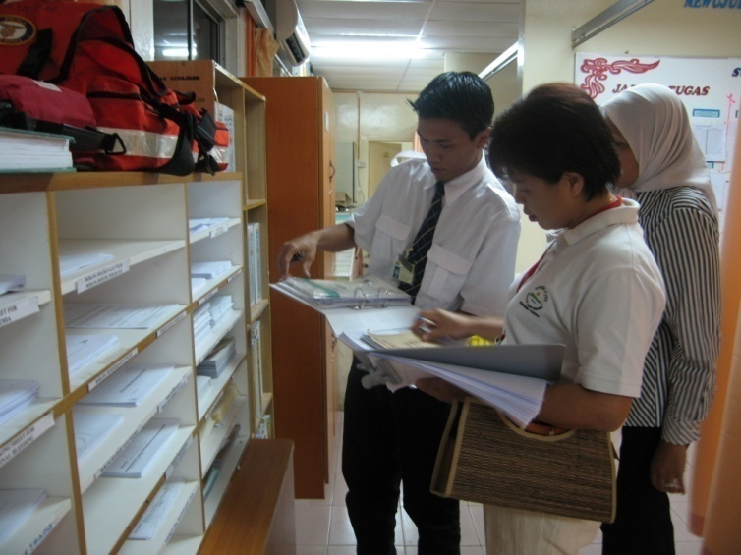
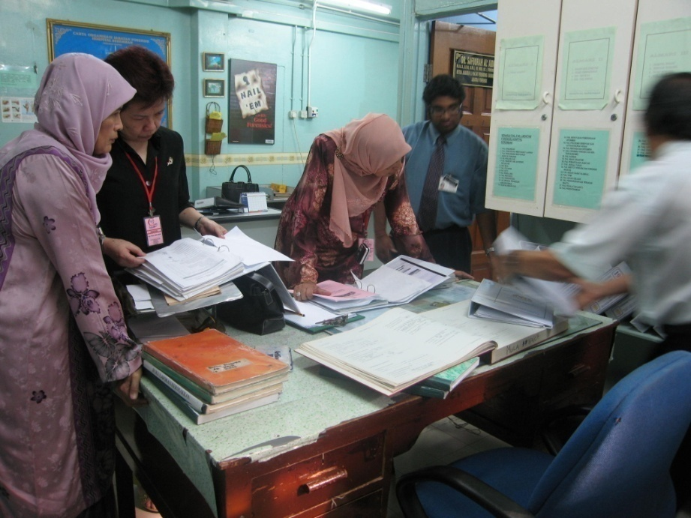
SURVEY IN PROGRESS

Slide 42
Hospital-wide Survey
Individual Surveyor Presentation
Survey Team Deliberation
Post Survey
- On Site
S1
S2
S3
S4
S5
ACCREDITATION AWARD
AN IMPARTIAL PROCESS
Secret Ballot
Vote
Vote
Vote
Vote
Vote
Survey Team Consensus
Hospital Identity Expunged
Edited Survey Report
Endorsement By Chief Surveyor
Final Survey Report
Minimum 3
Councillor 1
Councillor 2
Councillor 3
Independent Voting
Vote
Vote
Vote
MSQH
Endorsed by MCHS Chairman
Final Accreditation Status
Conferment of Accreditation Status by President MSQH
Notes:
42

Slide 43
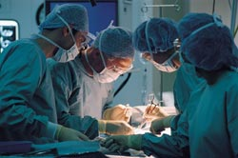

Certification decision
No compromise on Patient safety issues
Substantial Compliance to standards
Evidence of Continuous quality improvement activities in each service standards

Slide 44
AWARD
1.FULL ACCREDITATION = 4 YEARS
2. ONE YEAR ACCREDITATION
+ 3 YEARS
FOCUS SURVEY
3.NON - ACCREDITATION

Slide 45


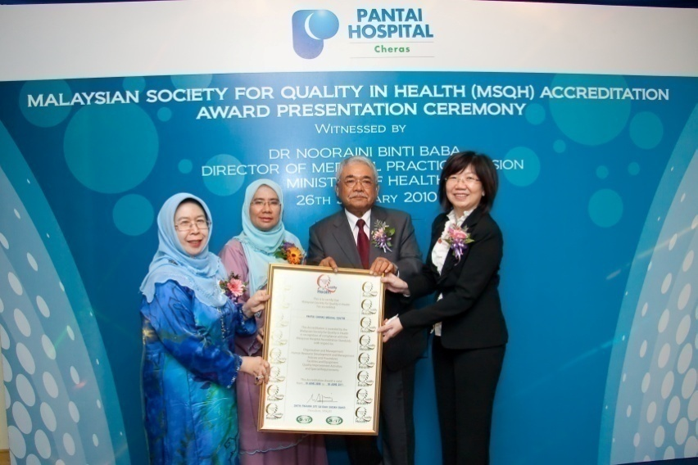

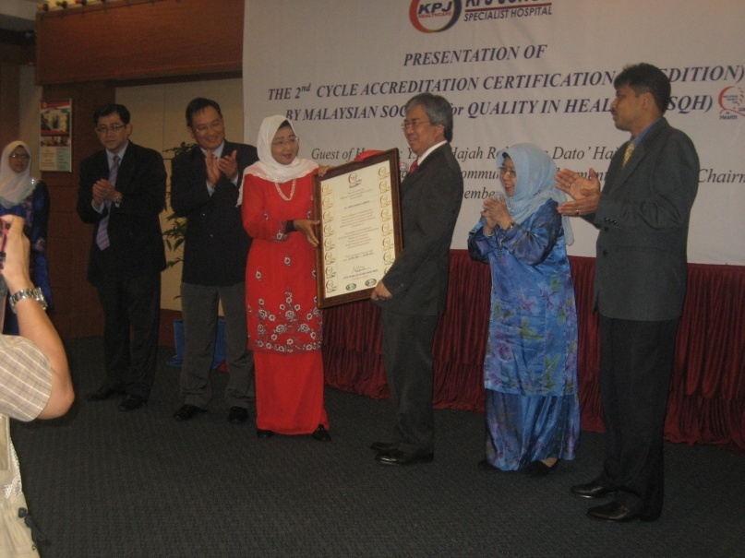

ACCREDITATION AWARD CEREMONY

Slide 46
Maintenance of Certification
Periodic assessment through 12 month compliance report
Surprise surveillance survey during 24 months
Periodic assessment through 36 month compliance report
Response to recommendations of survey team on opportunities for further improvement
Monitoring of adverse report/feedback from public

Slide 47

Withdrawal of Certification
Evidence of Compromised Patient safety
Negligence of care

Slide 48


Reflection on Safety
“Safety is a core value,
not a commodity that can be counted.
Safety shows itself
only by the events that do not happen.”
-Erik Hollnagel
Thank you
www.msqh.com.my
msqh@msqh.com.my

